Slide 1

PARKEZY-SMART CAR PARKING SYSTEM
by
2211CS050067 - S.Abhigna
2211CS050088-K.Varsha
2211CS050090-P.Rajeshri
Under the Guidance of:
Dr. Latha .G
Associate Professor
Department of IoT
School of Engineering
Malla Reddy University
Hyderabad, Telangana, INDIA

Slide 2
Contents :
i. Abstract
Introduction
1.1 Problem Definition & Descrition
1.2 Objective of the Project
1.3 Scope of the Project
2. System Analysis
2.1 Existing System
2.2 Proposed System
2.3 Software & Hardware Requirements
3. Architectural Design
3.1 Modules Design
3.2 Method & Algorithm Design
3.3 Project Architecture
4. Implementation & Testing
4.1 Code
4.2 Execution Flow
4.3 Test Cases

Slide 3
Abstract :
ParkEZY redefines parking management with its IoT-driven solution, seamlessly integrating technology to streamline the parking experience. By employing sensors at entry gates, the application autonomously opens gates upon vehicle detection, eliminating manual intervention. Real-time data analysis empowers users with instant updates on parking availability, while a visually intuitive interface provides a clear map of the parking area, showcasing vacant and occupied slots through color-coded indicators. This visual aid simplifies decision-making for drivers, reducing time spent searching for parking. ParkEZY's user-friendly design ensures a smooth interaction for both drivers and parking facility managers, promising enhanced efficiency and user satisfaction. With its innovative approach, ParkEZY sets a new standard in parking management, revolutionizing the way individuals navigate and utilize parking facilities.

Slide 4
1.Introduction
In today's urban landscapes, the search for parking often consumes valuable time and energy. Parkezy offers a solution to this perennial problem with its innovative IoT-based platform. By harnessing the power of real-time data and automation, Parkezy transforms parking management, providing drivers with instant access to available parking slots. Integrated with entry gate systems and equipped with ultrasonic sensors, Parkezy ensures a seamless parking experience from entry to slot selection. Through its intuitive web interface, users can effortlessly navigate parking availability, aided by visual indicators and real-time slot counts. This real-time information empowers drivers to make informed decisions and plan their parking strategy effectively, leading to a smoother and more efficient parking experience overall. Parkezy promises to revolutionize parking management, making the quest for parking a thing of the past.

Slide 5
1.Introduction
1.1 Problem Definition & Description
Parking inefficiencies plague urban areas, causing congestion and frustration due to a lack of real-time slot availability data and manual entry gate operations. Traditional systems fail to optimize resource allocation for operators and convenience for drivers. A modern solution like Parkezy is crucial to streamline parking management, enhancing the urban parking experience.
1.2 Objective of the Project
The objective of the project is to develop Parkezy, an IoT-based application, to provide real-time parking slot availability data, automate entry gate operations, and optimize parking resource management for enhanced urban parking experiences.
1.3 Scope of the Project
The project scope includes developing Parkezy's IoT infrastructure to integrate with parking facilities, implementing real-time data collection on parking slot availability, creating a user-friendly web interface, and automating entry gate operations to enhance urban parking management efficiency and user experience.

Slide 6
2.System Analysis
The system analysis for Parkezy begins with a meticulous gathering of requirements, utilizing surveys, interviews, and research to pinpoint user needs and technical specifications. Key functionalities such as real-time parking slot data collection, entry gate automation, and user interface design are delineated. This involves delineating hardware components like sensors and gate controllers, and software components such as the web interface and database. Data modeling is meticulously undertaken to design an efficient database schema capable of handling real-time updates and large data volumes.
During software development, robust backend services are crafted to process data, manage authentication, and control entry gates. Integration of IoT devices is meticulously executed, configuring sensors to detect vehicle presence and integrating data into the backend system for real-time updates. Stringent security measures are implemented to safeguard data transmission and access control. Thorough testing and quality assurance processes are conducted to validate functionality, reliability, and usability. Unit tests, integration tests, and user acceptance tests are performed to identify and rectify any issues or bugs.

Slide 7
2.System Analysis 2.1 Existing System 2.1.1 Background & Literature Survey
Research explores challenges faced in urban parking, solutions offered by IoT-based systems, and user preferences. Previous studies on sensor-based parking systems, entry gate automation, and real-time data visualization inform the development of Parkezy, guiding its design and functionality to address current shortcomings and meet user needs effectively.
2.1.2 Limitations of Existing System
Existing System has a lot of limitations such as lack of real-time data on parking slot availability, manual entry gate operations leading to delays, and inefficiencies in resource allocation. Traditional systems often suffer from inaccurate occupancy information. Moreover, the absence of user-friendly interfaces hampers the overall parking experience.

Slide 8
2.System Analysis
2.2Proposed System
Real-time Parking Availability: Parkezy provides up-to-the-minute data on parking slot availability, allowing drivers to find parking quickly and easily, reducing congestion and frustration.
Automated Entry Gate Operations: Integration with entry gate systems automates the process of granting access to parking facilities upon vehicle arrival, streamlining entry and reducing waiting times.
Efficient Resource Allocation: By accurately monitoring parking occupancy in real-time, Parkezy optimizes resource allocation, ensuring efficient use of parking spaces and minimizing wastage.
Enhanced User Experience: The intuitive web interface and visual indicators simplify the parking experience for users, enabling them to make informed decisions about where to park with ease.
Data-driven Insights: Parkezy collects valuable data on parking usage patterns, enabling parking facility operators to make informed decisions about capacity planning and resource management.

Slide 9
2.3 Software&Hardware Requirements 2.3.1 Software Requirements: Software Requirements include Arduino IDE, Windows 10 or 11, web server and programming language(C).
2.3.2 Hardware Requirements:
Hardware Requirements include ESP32, 2 IR Sensors, 4 Ultrasonic Sensors, Servo motors, I2C Module
2.4 Feasibility Study
2.4.1 Technical Feasibility:
Parkezy demonstrates technical feasibility through its integration of IoT sensors, gate control systems, and web interfaces to efficiently manage parking resources.
2.4.2 Robustness & Reliability:
Parkezy ensures robustness and reliability through rigorous testing, secure data transmission, and redundant systems, providing a dependable solution for parking management.
2.4.3 Economic Feasibility:
The economic feasibility of Parkezy is evident through potential cost savings from optimized resource allocation, increased revenue opportunities, and improved efficiency in parking management operations, outweighing initial development costs.

Slide 10
3. Architecture Design
3.1 Modules Design 3.1.1 Data Collection Module:
Responsible for gathering real-time information on parking slot occupancy.
This module integrates IoT sensors installed in each parking slot, continuously monitoring vehicle presence.
Data collected by these sensors are transmitted to the backend server for processing.
3.1.2 Feature Extraction Module:
Responsible for analyzing the raw data collected from the sensors and extracting relevant features.
This may include identifying patterns in parking occupancy, calculating occupancy rates, and detecting anomalies such as unauthorized parking or vehicle overstays.
These extracted features serve as input for various functionalities within the application, such as updating parking availability status on the web interface and generating insights for parking management decisions.

Slide 11
3.1.3 Entry Gate Control Module:
Automates entry gate operations upon vehicle arrival, ensuring seamless access to parking facilities.
Integrates with entry gate systems to authenticate vehicles and grant access based on real-time parking availability.
3.1.4 Frontend Interface Module:
Provides a user-friendly web interface for users to view parking availability and administrators to manage the system.
Enables intuitive navigation and interaction, enhancing the user experience and facilitating efficient system management.
3.1.5 User Interface Module:
Provides a user-friendly interface for users to view parking availability.
Allows users to interact with the system to reserve parking slots or access parking facilities.

Slide 12
3.1.6 IoT Integration Module:
Configures and deploys IoT sensors to detect vehicle presence and monitor parking occupancy.
Integrates sensor data with the backend system to provide real-time updates on parking availability.

Slide 13
3.2 Method & Algorithm Design
3.2.1 Parking Slot Detection Algorithm:
Utilizes data from IoT sensors to detect the presence of vehicles in parking slots.
Implements algorithms such as thresholding, edge detection, or machine learning-based classification to accurately identify occupied and vacant parking slots.
3.2.2 Entry Gate Automation Algorithm:
Monitors incoming vehicle data to detect arrivals at entry gates.
Implements decision-making algorithms to automate gate operations, such as opening or closing gates based on vehicle presence and system status.
3.2.3 Real-time Data Processing Method:
Implements efficient data processing methods to handle real-time updates on parking slot availability.
Utilizes streaming data processing techniques or batch processing algorithms to ensure timely updates on the frontend interface.

Slide 14
3.2 Method & Algorithm Design
3.2.4 Fault Tolerance and Redundancy Methods:
Implements fault tolerance mechanisms and redundancy strategies to ensure system reliability.
Utilizes algorithms for error detection, recovery, and failover to minimize downtime and maintain system availability.
3.2.5 Integration Algorithms:
Designs algorithms for seamless integration between different system modules, including data collection, entry gate control, backend services, and frontend interface.
Ensures smooth communication and data exchange between modules to provide a cohesive user experience.

Slide 15
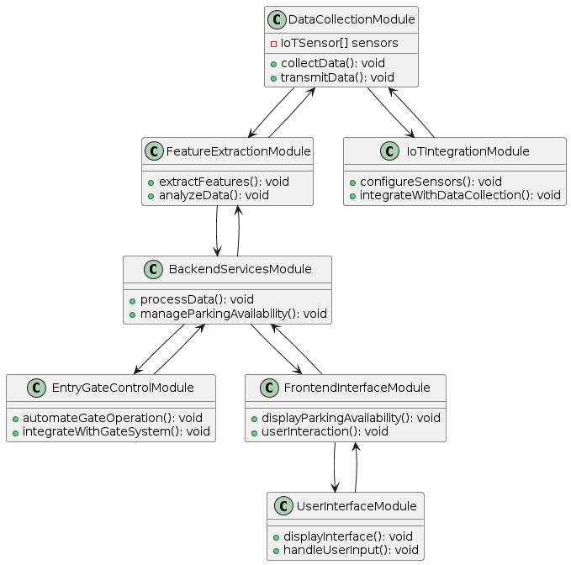
3.3 Project Architecture
3.3.1 Architecture Diagram

Slide 16
3.3.1 Architecture Diagram
IoT Sensor: This component represents the physical sensors installed in parking slots. These sensors detect the presence of vehicles in real-time.
Entry Gate Controller: The entry gate controller automates the operation of entry gates based on data received from the IoT sensors. It ensures seamless access to parking facilities for vehicles.
Backend Service: Responsible for processing data from sensors and managing parking availability. It handles tasks such as analyzing sensor data, updating parking availability status, and managing user interactions.
Frontend Interface: The frontend interface provides a user-friendly web interface for users to interact with the system. It displays real-time parking availability information and allows users to reserve parking slots.

Slide 17
3.3.2 Data Flow Diagram
IoT Sensors
Entry Gate
Controller
Backend Service
Detection Data
Control Signals
Data Updates
IR Sensors
Ultrasonic Sensors
Servo Motor
LCD Display
Parking Data
Parking Data Updates
Frontend Interface
(Website)

Slide 18
3.3.2 Data Flow Diagram
IoT Sensors (IR Sensor, Ultrasonic Sensors): Detect vehicle presence and occupancy in parking slots.
Entry Gate Controller (Servo Motor): Controls the entry gate based on vehicle detection and system commands.
Backend Service: Processes sensor data, controls gate operations, and updates parking availability in the database.
Database (Parking Data): Stores parking slot occupancy data for real-time updates and retrieval.
Frontend Interface (Website): Displays parking availability information to users and provides a user interface for interaction.

Slide 19
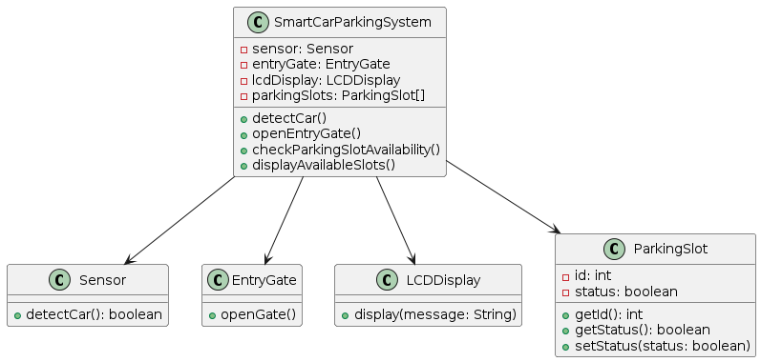
3.3.3 Class diagram :

Slide 20
3.3.3 Class diagram :
Sensor Class:
Represents the IoT sensors used for detecting vehicle presence and occupancy in parking slots.
Methods include detectCar() to sense vehicle presence and collect data.
EntryGate Class:
Manages the entry gate control system, responsible for automating gate operations.
Methods include openGate() to control the gate based on sensor data.
LCDDisplay Class:
Represents the LCD display used for showing the number of available parking slots.
Methods include display(message : string) to refresh the display with real-time parking availability information.
Parkingslot Class:
Represents individual parking slots within the parking area.
Each instance of this class may have attributes such as slot number, occupancy status, and availability status.

Slide 21
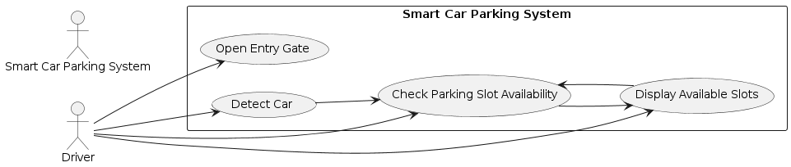
3.3.4 Use-case diagram :
View Parking Availability:
Users can view the current parking availability status through the frontend interface. This use case allows users to quickly assess the availability of parking slots before entering the parking area.
Automate Entry Gate Operations:
The entry gate controller automatically operates the entry gate based on vehicle presence detected by sensors. This use case facilitates smooth entry for vehicles into the parking area.
Detect Vehicle Presence:
IoT sensors detect vehicle presence in parking slots, triggering actions such as updating parking availability status and controlling entry gate operations. This use case ensures accurate monitoring of parking occupancy status.
Display Parking Information:
The frontend interface displays parking availability information to users in a user-friendly manner. This use case involves presenting real-time updates on available parking slots and facilitating user interactions.

Slide 22
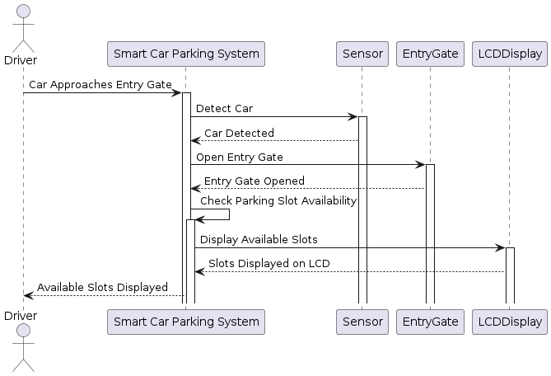
3.3.5 Sequence diagram :

Slide 23
The sequence diagram illustrates the chronological flow of interactions within the Parkezy application.
It starts with a user accessing the frontend interface to view parking availability.
Upon selecting a parking slot for reservation, the frontend interface communicates with the backend service to process the reservation request.
Simultaneously, IoT sensors detect vehicle arrival at the entry gate, triggering the entry gate controller to raise the gate for vehicle entry.
As vehicles enter and exit the parking area, IoT sensors continuously update the backend service with occupancy status, which, in turn, updates the database.
This information is reflected in real-time on the frontend interface, allowing users to monitor parking availability and make informed decisions.

Slide 24
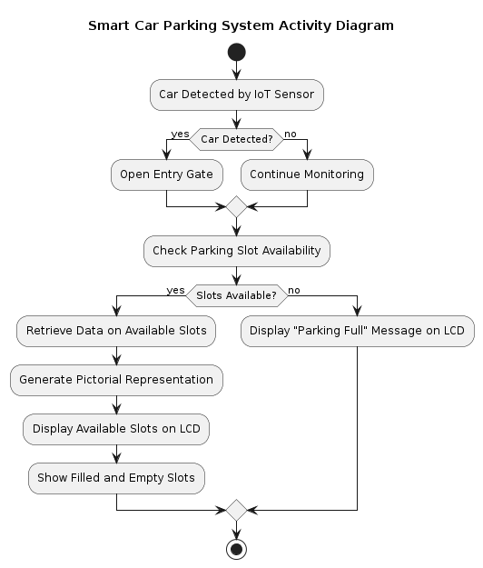
3.3.6 Activity diagram :

Slide 25
User Interaction: The activity diagram begins with the user interacting with the frontend interface of the Parkezy application. Users have the option to view parking availability and reserve parking slots.
View Parking Availability: Users can view the current parking availability status through the frontend interface. This activity involves accessing the interface and retrieving parking availability data from the backend service.
Entry Gate Control: Simultaneously, IoT sensors detect vehicle arrival at the entry gate. The entry gate controller is activated to raise the entry gate, allowing the vehicle to enter the parking area.
Update Parking Availability: As vehicles enter and exit the parking area, IoT sensors continuously update the backend service with occupancy status. The backend service updates the database accordingly, reflecting real-time parking availability status on the frontend interface.
Continued Monitoring: The system continues to monitor parking occupancy status and update the frontend interface accordingly. Users can interact with the interface to view parking availability, reserve parking slots, and receive real-time updates on parking status.

Slide 26
4. Implementation & Testing
4.1 Code:
4.1.1 Data acquisition and sensing firmware for ESP32:
#include <Wire.h>
#include <LiquidCrystal_I2C.h>
#include <ESP32Servo.h>
LiquidCrystal_I2C lcd(0x27,16,2);
Servo myservo1;
int IR1 = 2;
int IR2 = 4;
int Slot = 5;
int flag1 = 0;
int flag2 = 0;

Slide 27
4.1.1 Data acquisition and sensing firmware for ESP32:
void setup() {
Wire.begin();
Serial.begin(9600);
while (!Serial); // Wait for serial monitor
lcd.begin(16, 2); // Initialize LCD with 16 columns and 2 rows
lcd.backlight();
pinMode(IR1, INPUT);
pinMode(IR2, INPUT);
myservo1.attach(3);
myservo1.write(100);
lcd.setCursor(0, 0);
lcd.print(" ARDUINO ");
lcd.setCursor(0, 1);
lcd.print(" PARKING SYSTEM ");
delay(2000);
lcd.clear();
}

Slide 28
4.1.1 Data acquisition and sensing firmware for ESP32:
void loop() {
byte error, address;
int nDevices;
Serial.println("Scanning...");
nDevices = 0;
for(address = 1; address < 127; address++) {
Wire.beginTransmission(address);
error = Wire.endTransmission();
if (error == 0) {
Serial.print("I2C device found at address 0x");
if (address<16)
Serial.print("0");
Serial.print(address,HEX);
Serial.println(" !");
nDevices++;
} else if (error==4) {
Serial.print("Unknown error at address 0x");
if (address<16)
Serial.print("0");
Serial.println(address,HEX);
}

Slide 29
4.1.1 Data acquisition and sensing firmware for ESP32:
if (nDevices == 0)
Serial.println("No I2C devices found\n");
else
Serial.println("done\n");
delay(5000); // wait 5 seconds for next scan
if(digitalRead (IR1) == LOW && flag1==0) {
if(Slot>0) {
flag1=1;
if(flag2==0) {
myservo1.write(0);
Slot = Slot-1;
}
} else {
lcd.setCursor(0,0);
lcd.print(" SORRY :( ");
lcd.setCursor(0,1);
lcd.print(" Parking Full ");
delay(3000);
lcd.clear();
}
}

Slide 30
4.1.1 Data acquisition and sensing firmware for ESP32:
if(digitalRead (IR2) == LOW && flag2==0) {
flag2=1;
if(flag1==0) {
myservo1.write(0);
Slot = Slot+1;
}
}
if(flag1==1 && flag2==1) {
delay(1000);
myservo1.write(100);
flag1=0;
flag2=0;
}
lcd.setCursor(0,0);
lcd.print(" WELCOME! ");
lcd.setCursor(0,1);
lcd.print("Slot Left: ");
lcd.print(Slot);
}

Slide 31
4.2 Execution Flow:
4.2.1 Initialization:
Initialize all hardware components and establish connections (Wi-Fi) for data transmission.
Set up configurations and parameters for sensor monitoring and data processing.
4.2.2 Data Sensing:
Sensors continuously monitor the parking area to detect the presence or absence of vehicles.
Data from sensors are collected periodically to update the system on parking occupancy status.
4.2.3 Data Collection:
When a vehicle is detected by the sensors, data regarding its presence or absence is collected and processed by the ESP32 microcontroller.

Slide 32
4.2.4 Gate Control:
If a vehicle is detected at the entry gate, the servo motor is activated to raise the gate.
Gate control ensures smooth entry for vehicles into the parking area.
4.2.5 Display Update:
The LCD display is updated with real-time information on the number of available parking slots.
Users can quickly see the current parking availability status before entering the parking area.
4.2.6 Backend Processing:
Upon receiving data from the ESP32, the backend service processes the information.
Data processing includes validation, analysis, and updating the database with parking availability status.

Slide 33
4.2.7 User Interface Update:
The frontend interface (website) retrieves updated parking availability data from the database.
User interface updates provide users with real-time information on parking availability for informed decision-making.
4.2.8 User Interaction:
Users can interact with the website interface to view parking availability and reserve parking slots.
User interaction enhances user experience and facilitates efficient parking management.
4.2.9 Continued Monitoring:
The application continuously monitors the parking area, updating data and user interfaces as parking occupancy status changes.
Continuous monitoring ensures that users have access to up-to-date information on parking availability at all times.

Slide 34
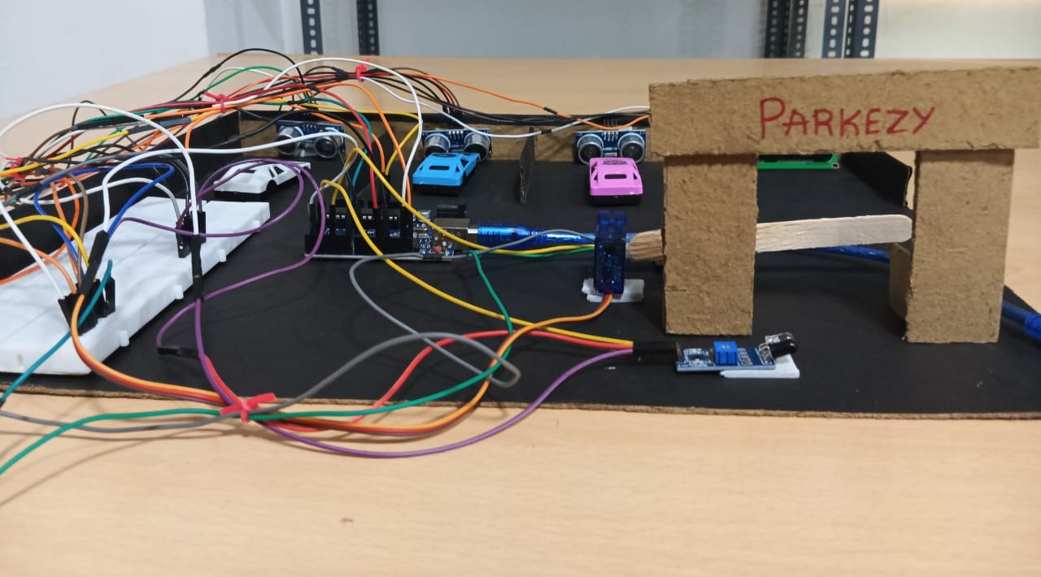
4.3 Test Cases:
4.3.1
Make sure all sensors are working correctly by checking if they can detect cars and measure distances accurately.
Test the entry gate to see if it opens automatically when a car arrives and if it stays closed when all parking slots are full.
Check that the LCD displays the slot status that is no.of slots avilable .
Observe that the ultrasonic sensor detects the vehicle and it is displayed on the serial monitor.

Slide 35
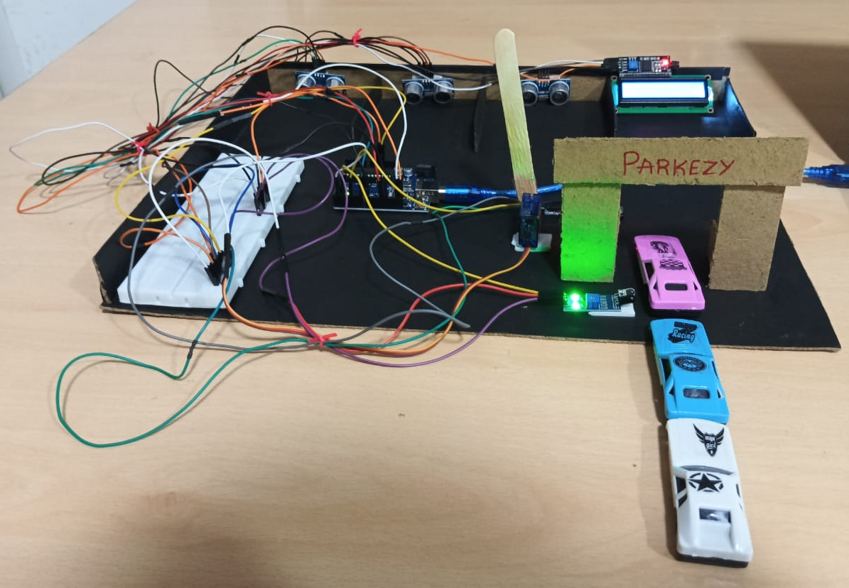
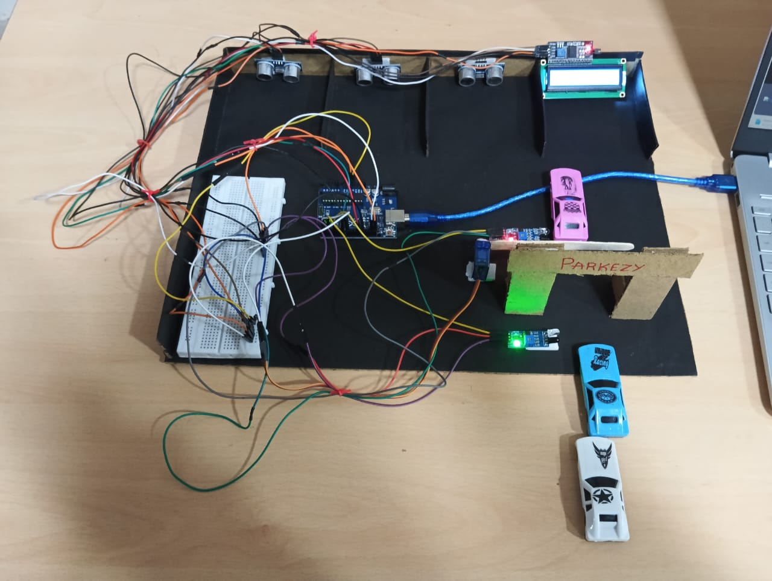
4.3 Test Cases:
4.3.2 IR Sensor detects the arrival of the car and servo motor opens the entry gate .
4.3.3 IR Sensor detects the departure of the car and servo motor closes the entry gate .

Slide 36
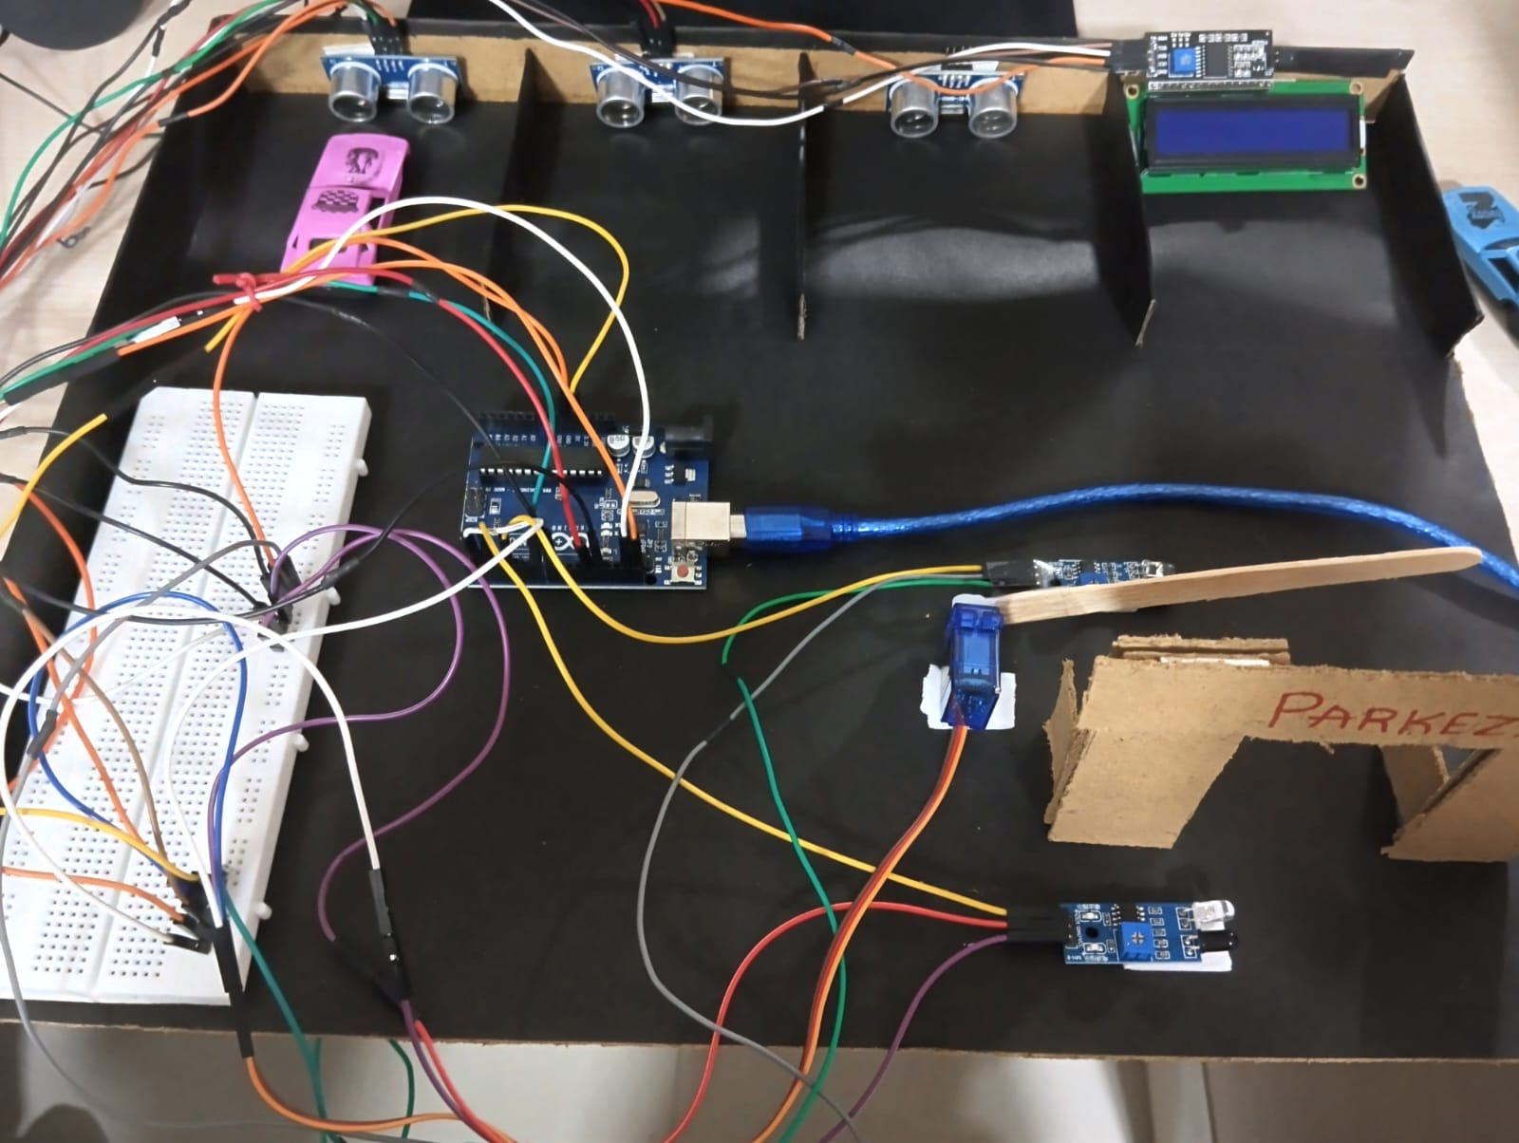
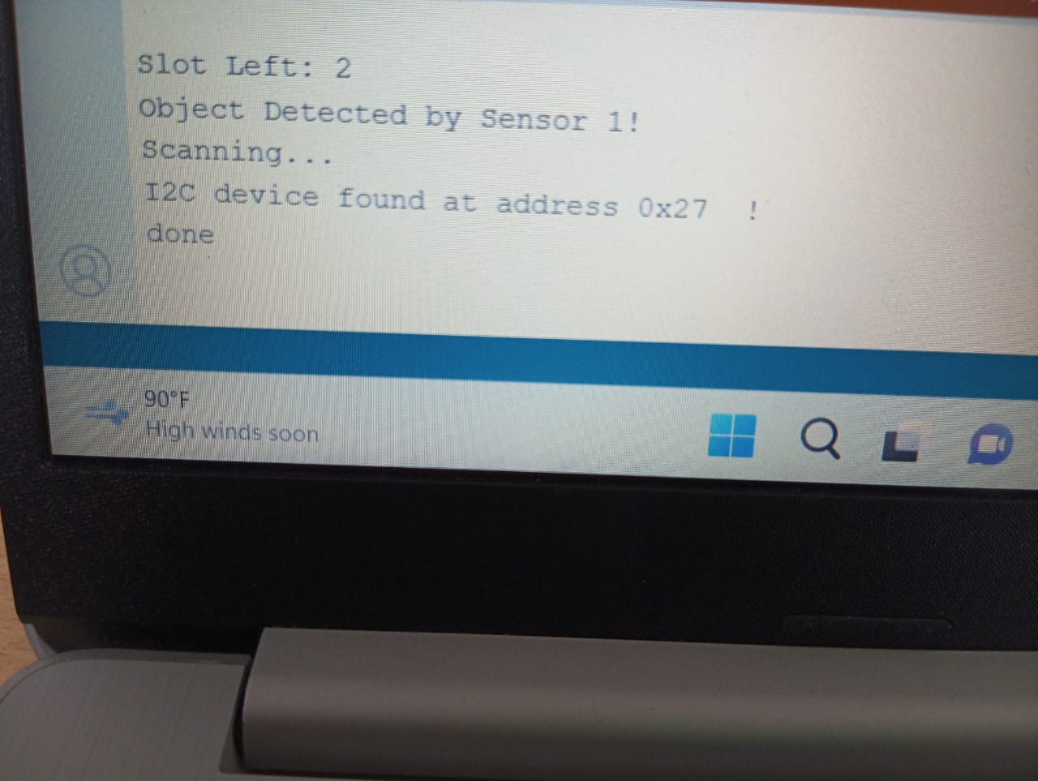
4.3 Test Cases:
4.3.4 Here, the ultrasonic sensor detects the presence of the car and shows the status of the available slots

Slide 37

Thank You

